Slide 1
The consultant mart
Sports
Toys
Clothes
Utensils
Footwear
Gaming
Decoration
Artificial jewellery
Electronic
Hardware
Plumbing
Tiles

Slide 2
The consultant^{Mart}
Home | Items | About us | Policies | Coriers | Terms and Conditions | Contact us | Feedback | Cart /Payment
Sports | Toys | Clothes | Utensils
Footwear | Gaming | Decoration | Artificial jewellery
Hardware | Mobile Accessories | Bed Sheets | Mats

Slide 3
Sports
Home | Items | About us | Policies | Coriers | Terms and Conditions | Contact us | Feedback | Cart /Payment
Sports
Footwear
Hardware
Toys
Gaming
Mobile Accessories
Decoration
Bed Sheets
Artificial jewellery
Mats
Clothes
Utensils
Cricket | Football | Badminton | Fitness | Swiming
Bats | Ball | Rackets
Gloves | Kit | Shuttle cork
Gards | Customise Kit | Kit
Pads | Shoes | Net
Balls | Keeper kit
Wickets | Shin Pads
Grips
Kit

Slide 4

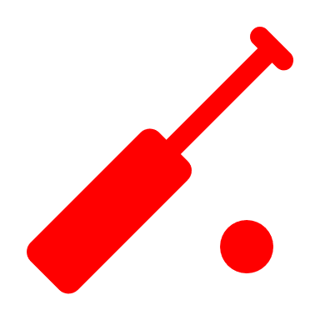
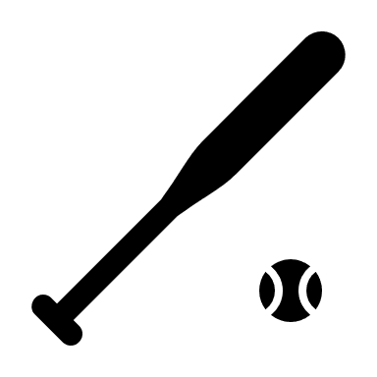
Bats
Home | Items | About us | Policies | Coriers | Terms and Conditions | Contact us | Feedback | Cart /Payment
Sports | Cricit
 | Football
 | Badminton
 | Fitness
 | Swimming
Footwear
Hardware
Toys
Gaming
Mobile Accessories
Decoration
Bed Sheets
Artificial jewellery
Mats
Clothes
Utensils
 | Explanations Wood Wt Str
 | Explanations Wood Wt Str
 | Explanations Wood Wt Str

Slide 5




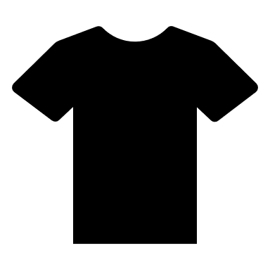


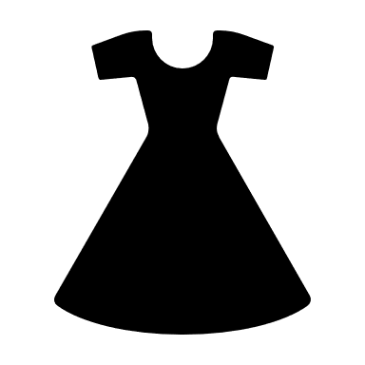


The consultant mart

Slide 6
The Med Eqpt

Slide 7
The consultant mart

Slide 8
The consultant mart

Slide 9
The consultant mart

Slide 10
The consultant mart

